Slide 1


ORGANIZATIONAL PRESENTATION
Employee Experience Survey Process
Let’s create a workplace experience that reflects and inspires us! 🚀
[Date of presentation]

Slide 2



Why Team Up With Amélio?
Because your opinion matters!
Amélio is a survey platform designed to give teams a voice. In just a few minutes, you can share what you experience, what you appreciate, and what you’d like to see evolve.
Your answers help us:
✔ better understand your reality
✔ highlight what’s working well
✔ take action on what concerns you
The more people who participate, the clearer the picture of your experience and the better we can move forward together.

Slide 3
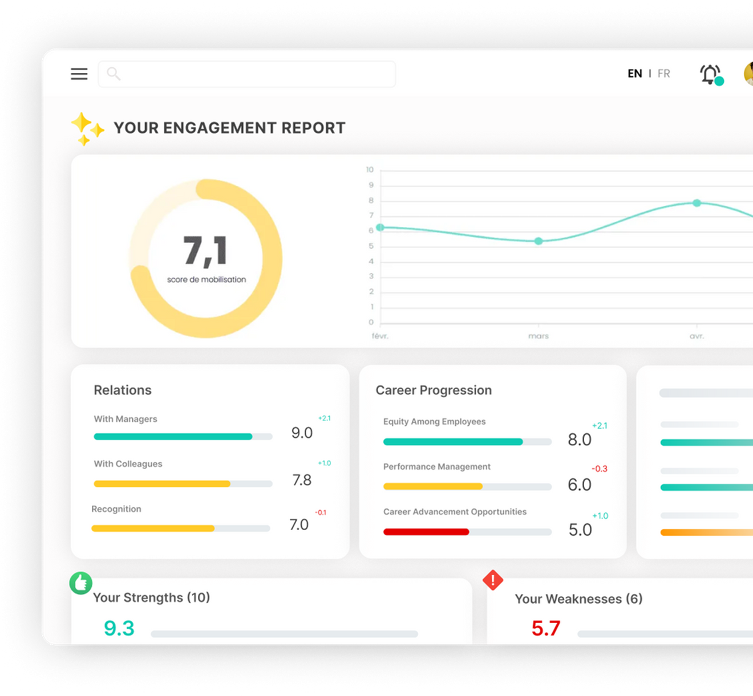
A Confidential Survey
1
Your manager will have access to results and comments if the confidentiality threshold is met.
2
The confidentiality threshold is 5 respondents per team for results to be displayed.
3
Your comments help us better understand your concerns and identify actionable improvements.
4
Amélio never reveals the identity linked to participants responses.

Slide 4
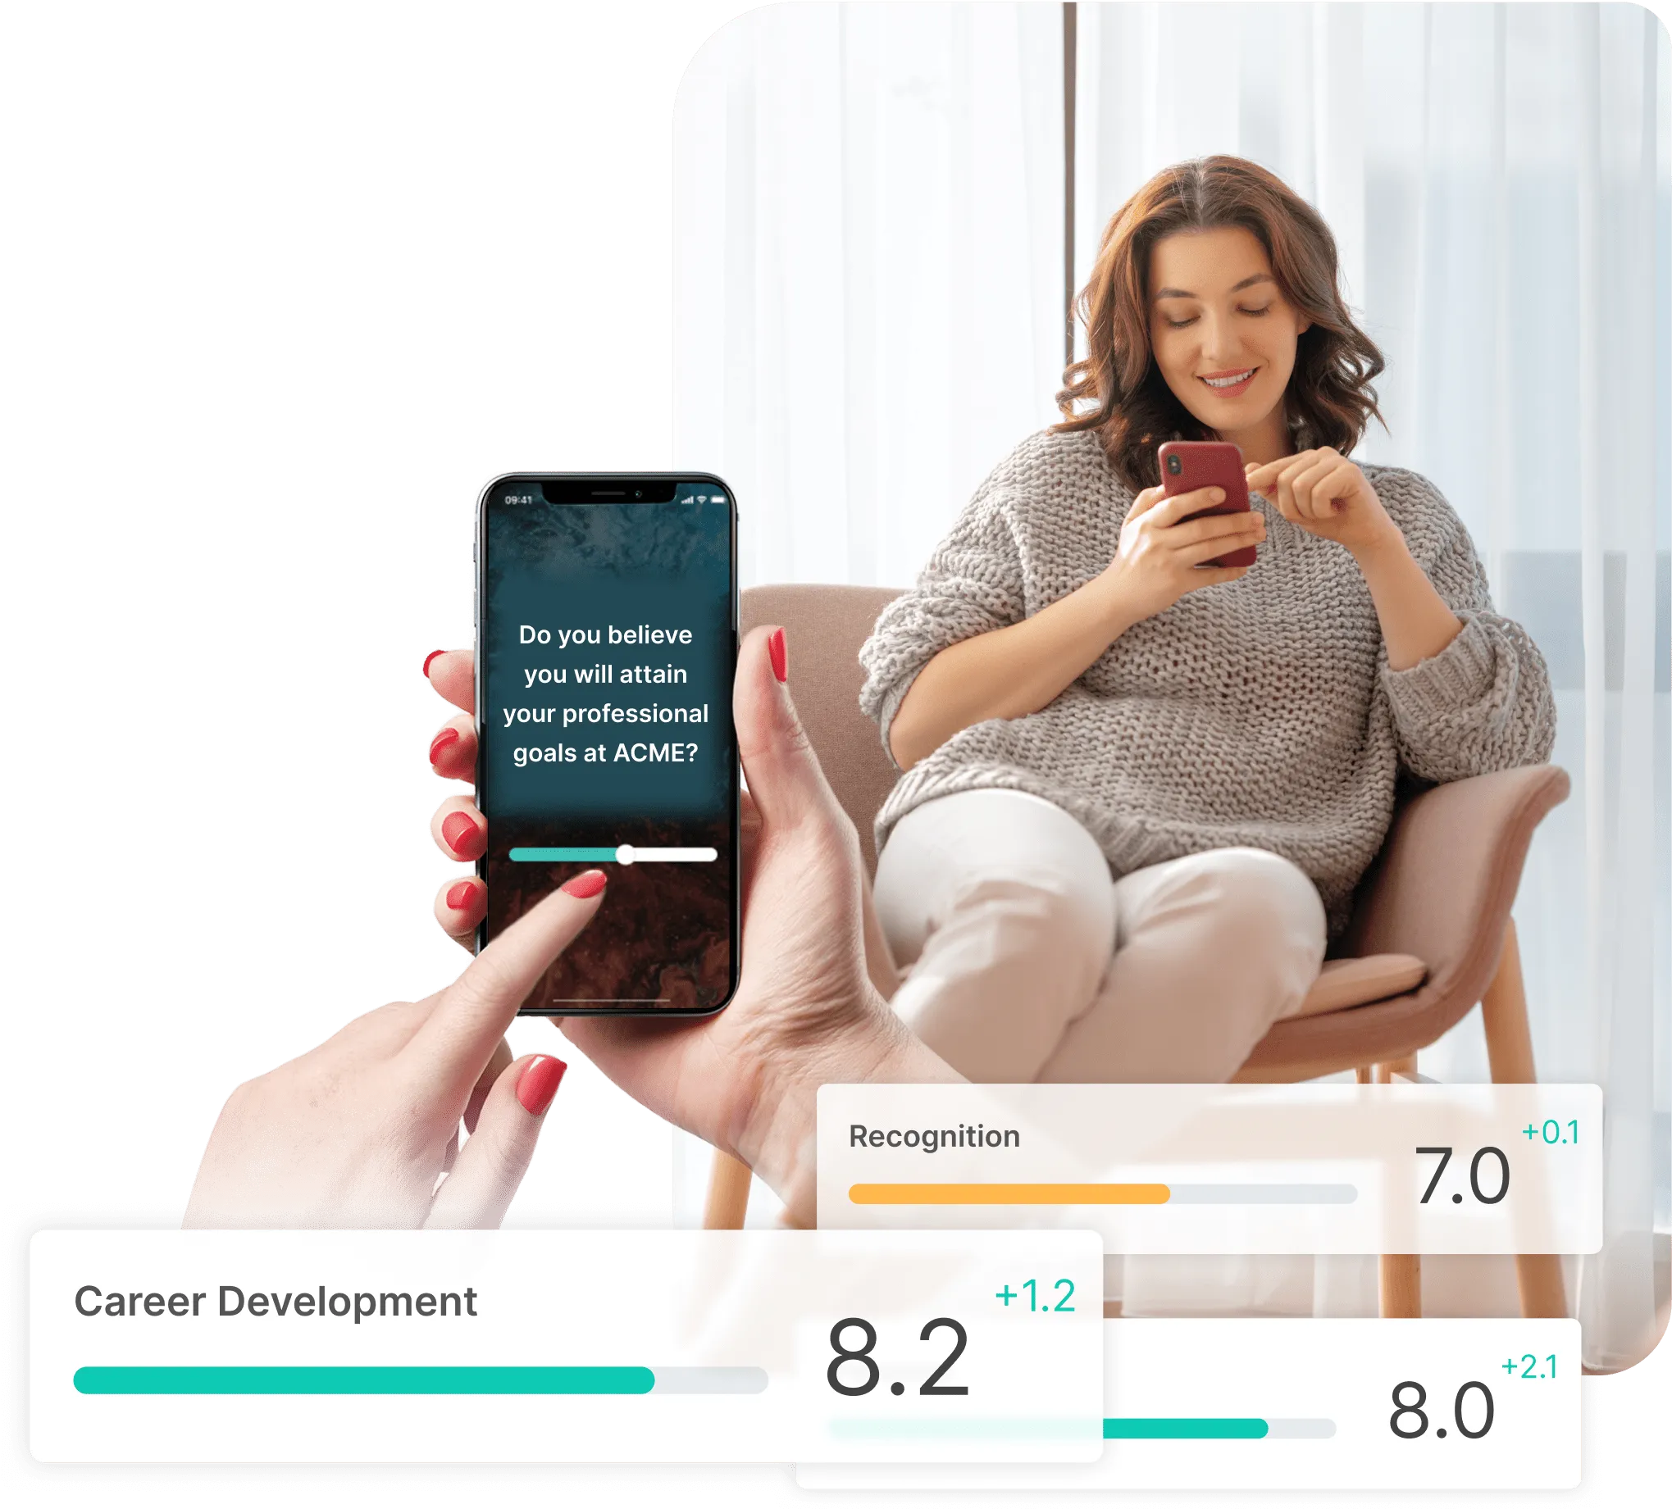

Your Role
✔ Answer honestly, whether it’s positive or constructive.
✔ Highlight what you appreciate using concrete examples so we can celebrate and continue our efforts.
✔ Share your concerns so we can understand what needs improvement and how to make it better.
✔ Offer solutions that could be explored by your team right away.
Target participation rate
We’re confident we can reach an optimal participation rate.
Your manager will allocate time for you to complete the survey.

Slide 5





Key Information
Ongoing survey
Survey Launch
Delivery Method
Estimated Duration
Survey Frequency
[Date]
[Time]
By email
QR Code
[20 questions]
[10 minutes]
[Every 2 weeks]

Slide 6

Key Information
Organizational diagnostic
Survey Launch
Delivery Method
Estimated Duration
Survey Closure
[Date]
[Time]
By email
QR Code
Universal link
[20 minutes]
[Date]
[Time]

Slide 7
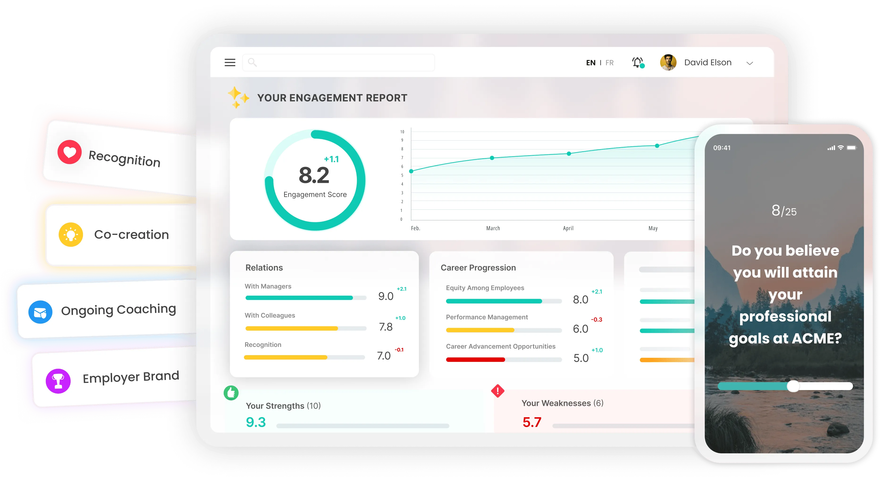
Complementary Modules
Tools to improve our practices!
On [Date]
1
You’ll receive an email to log into the Amélio platform.
2
You’ll be able to access Amélio modules at any time at any time.
3
Let’s explore these modules together today!

Slide 8
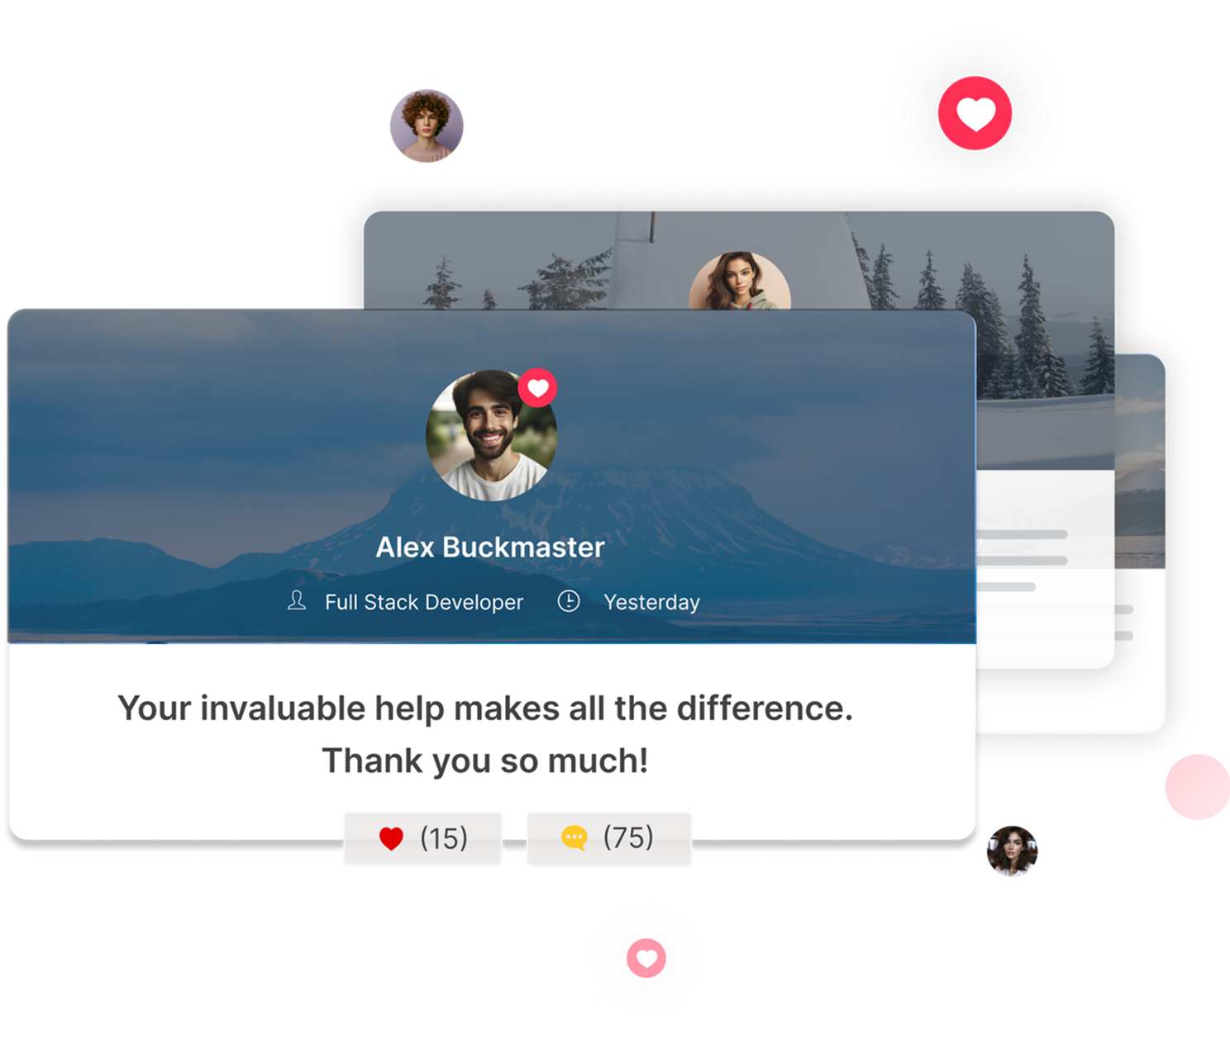

Complementary Modules
Peer-to-peer Recognition
Brighten your colleagues’ day!
A tool designed to let you give private or public recognition and strengthen the sense of belonging across the organization.
Use customizable cards - Celebrate appreciated behaviors aligned with our culture.
Spotlight efforts – Acknowledge successes, contributions, and involvement of your colleagues.
Amplify positivity - React to recognitions to show support and increase impact.
Gain visibility - Your manager will be notified when you receive recognition.

Slide 9
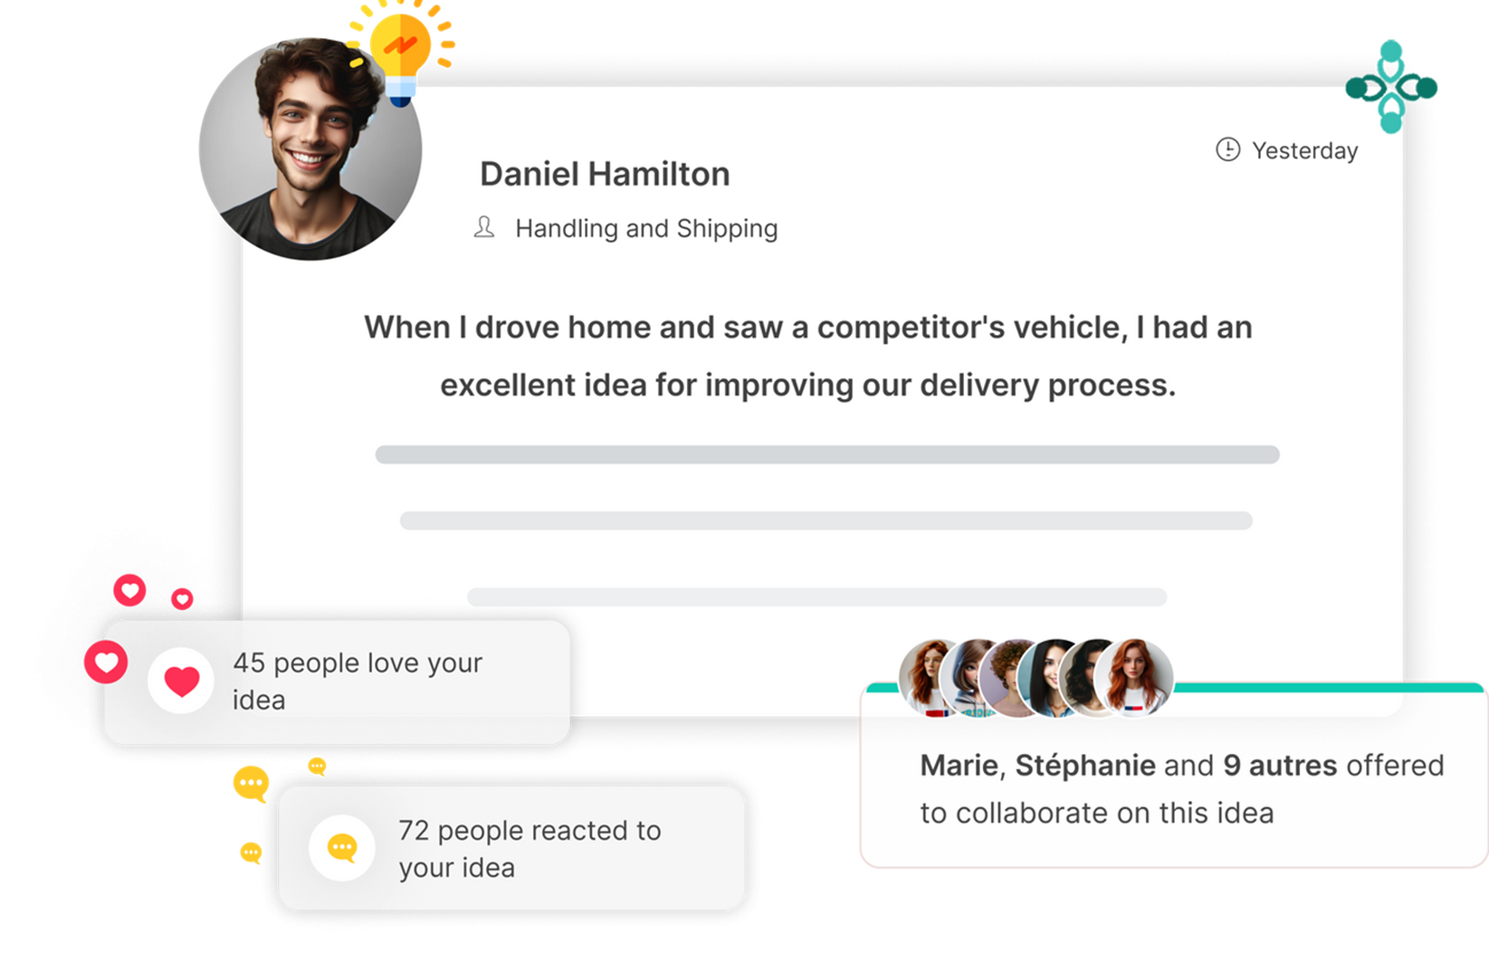

Complementary Modules
CoLab
Take part in decisions and transformations!
A tool designed to tap into collective intelligence and find concrete solutions to challenges or strategic issues.
Share your expertise - Propose improvement ideas aligned with real experiences.
Fuel reflection - React to ideas shared by your colleagues and move the discussion forward.
Break the routine - Volunteer to collaborate on ideas that excite you.

Slide 10
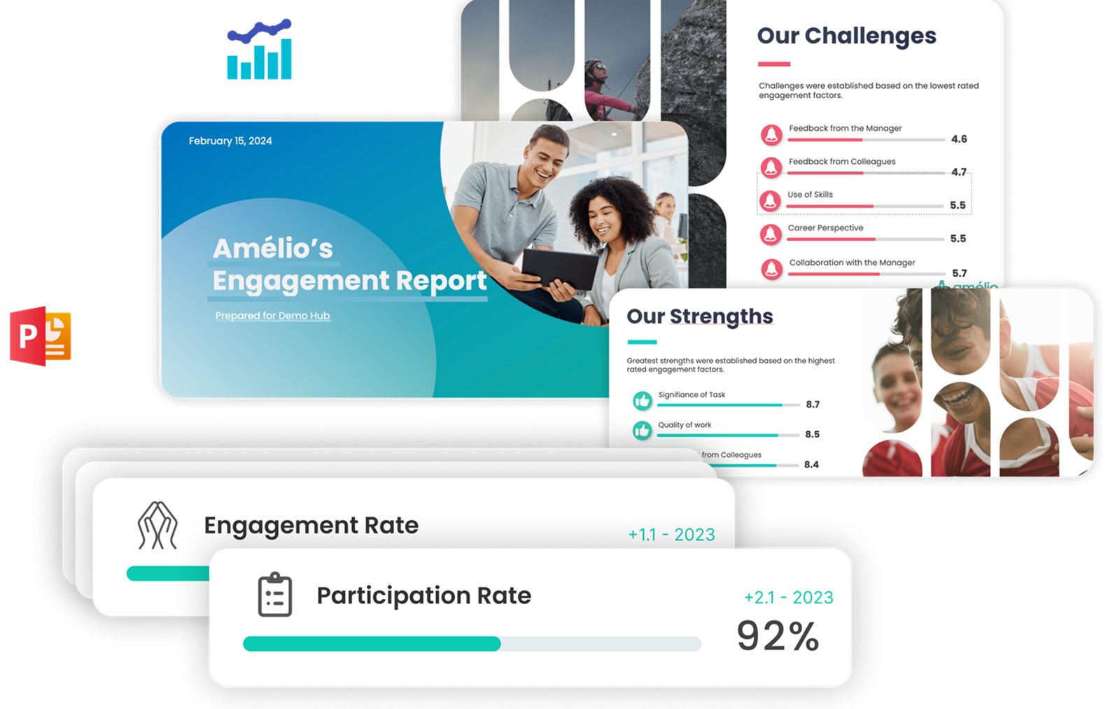
Next Steps
  Results analysis[Date to date]
  Highlighting our collective strengths
  Action plan to address raised concerns
Mobilization is a shared responsability!
Everyone has a role to play in building a workplace that reflects and inspires us.🚀

Slide 11

Q&A Session

