Slide 1


MANAGERS PRESENTATION
Employee Experience Survey Process
Let’s create a workplace experience that reflects and inspires us! 🚀
[Date of presentation]

Slide 2

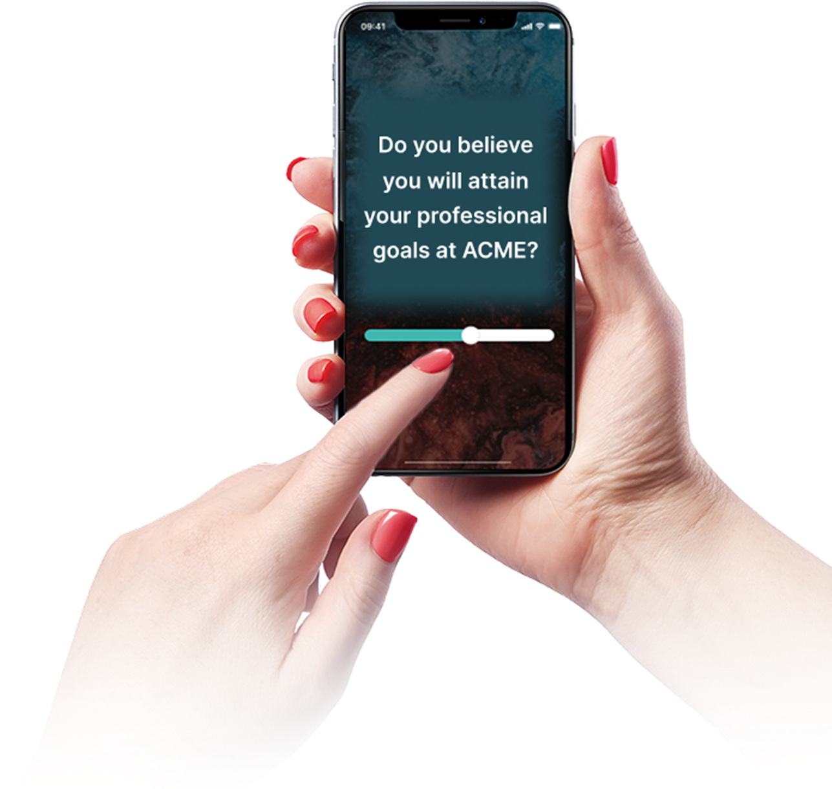

Why Team Up With Amélio?
Because you play a key role in supporting engagement!
Amélio is a survey platform that helps you better understand what your team members are experiencing, by giving them a confidential space to express themselves.
Thanks to this tool, you will be able to:
✔Get a clear, structured view of your team’s experience
✔ Quickly identify strengths and areas of concern
✔ Take concrete actions based on reliable data
✔ Build trust by showing that their voices are heard
The more your employees participate, the more you'll have concrete levers to act quickly and improve the employee experience in the right direction.

Slide 3
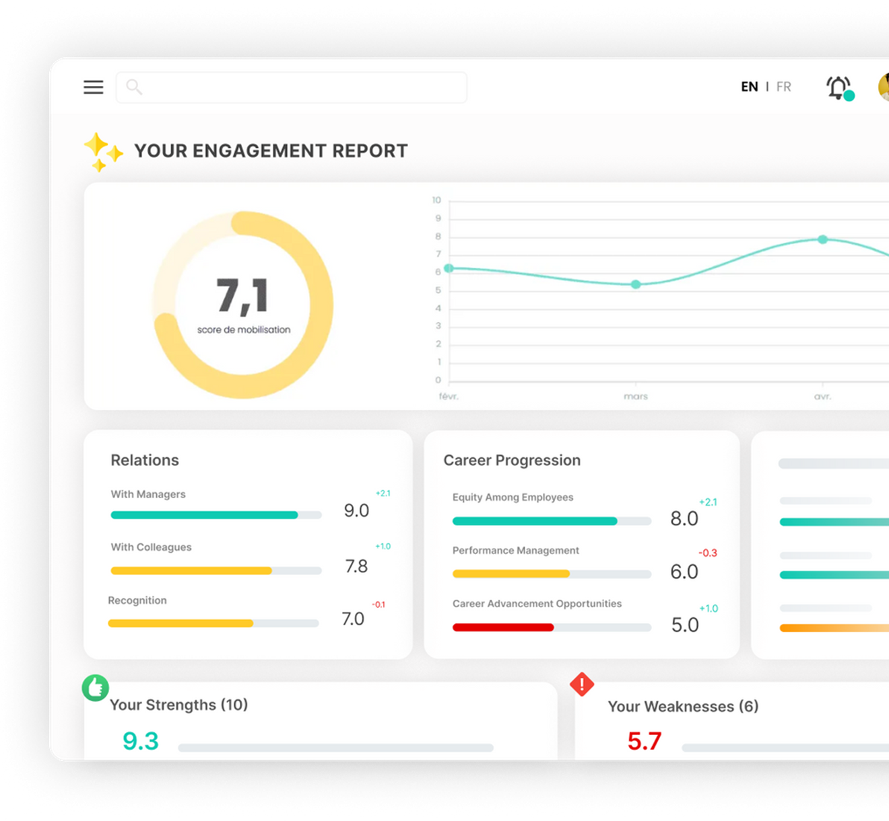
A Confidential Survey
1
You’ll exclusively have access to results and comments if the confidentiality threshold is met.
2
The confidentiality threshold is 5 respondents per team for results to be displayed.
3
Comments are not meant to identify individuals, but to better understand their concerns and surface actionable improvements.
4
Amélio never reveals the identity linked to participants responses.

Slide 4
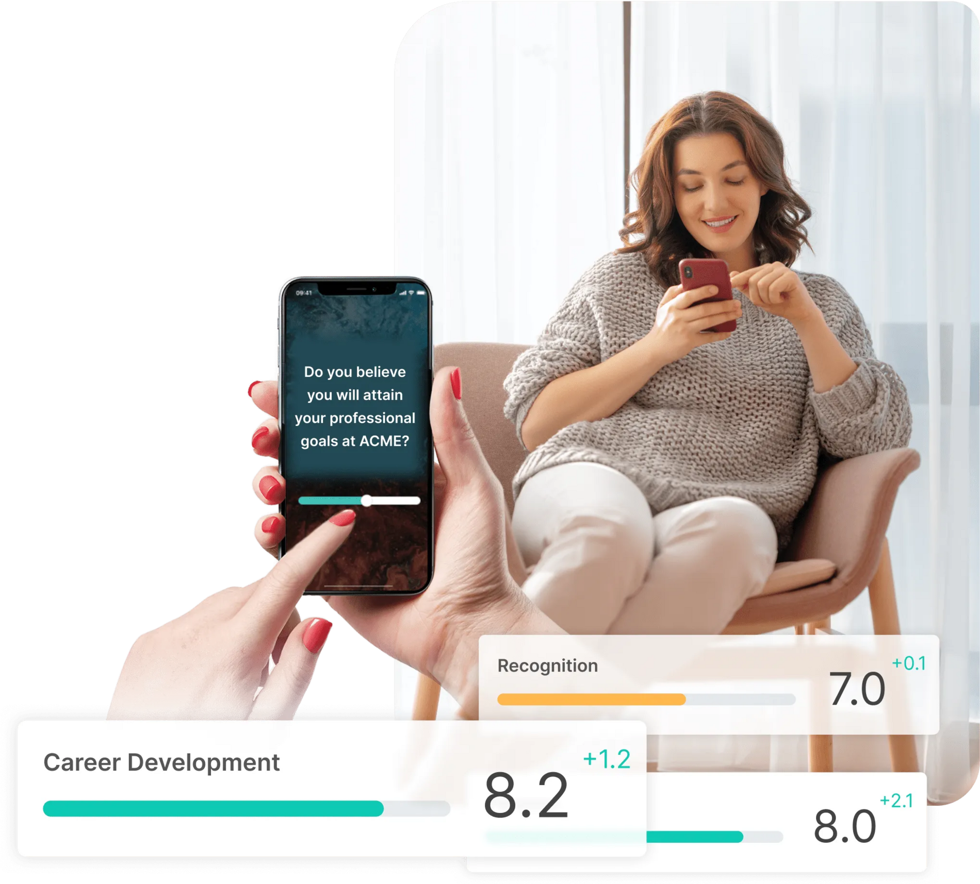
Your Role
✔ Inform your employees about the survey and explain its importance.
✔ Encourage participation by fostering a climate of openness and trust.
✔ Answer questions and address any concerns around confidentiality and how results will be used.
✔ Set the tone by actively participating and valuing the outcomes.
Best Practices
Monitor participation rates within your team
Schedule time for employees to complete the survey.

Slide 5





Key Information
Ongoing survey
Survey Launch
Delivery Method
Estimated Duration
Survey Frequency
[Date]
[Time]
By email
QR Code
[20 questions]
[10 minutes]
[Every 2 weeks]

Slide 6

Key Information
Organizational diagnostic
Survey Launch
Delivery Method
Estimated Duration
Survey Closure
[Date]
[Time]
By email
QR Code
Universal link
[20 minutes]
[Date]
[Time]

Slide 7
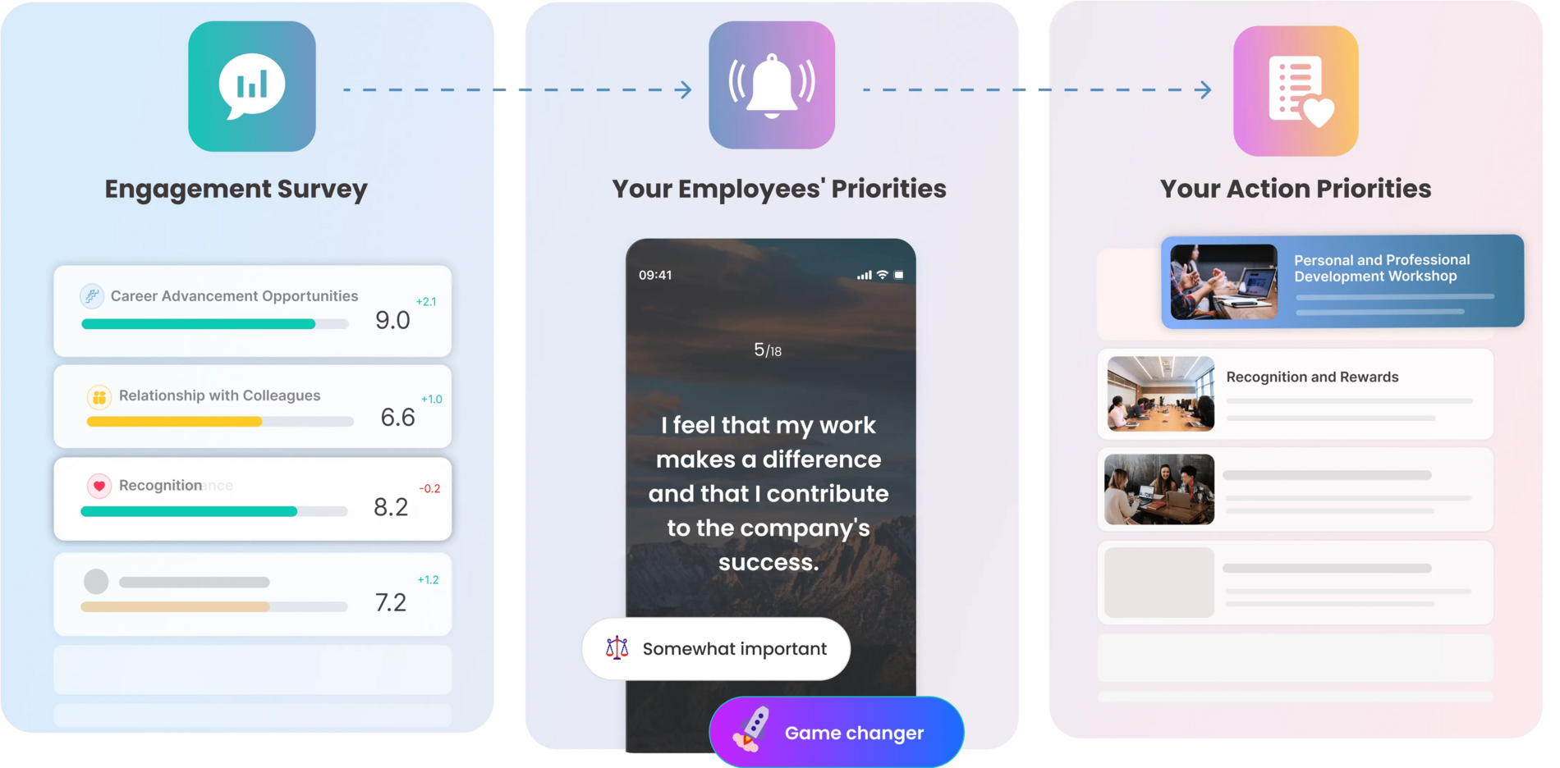
Act Quickly
A tool designed to identify what matters most.

Slide 8
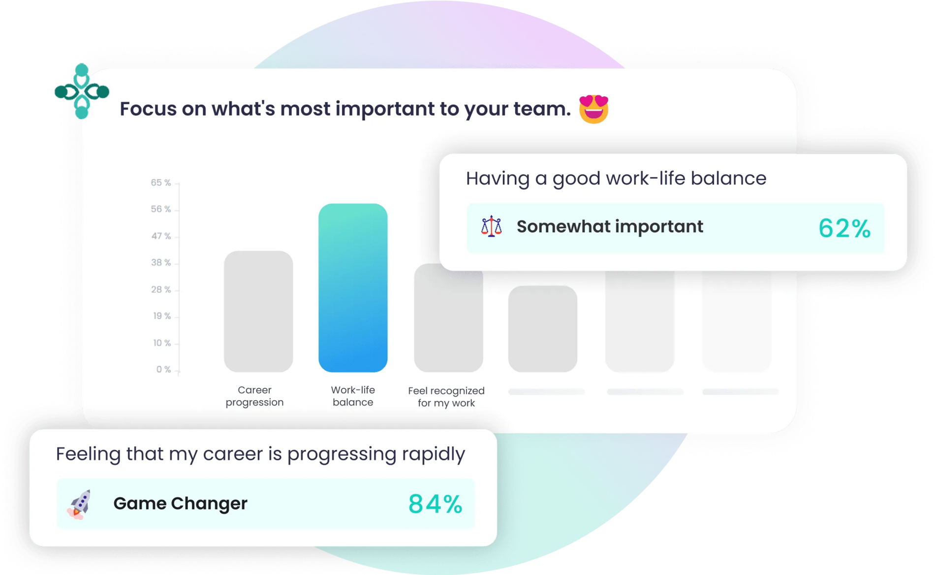
Act Quickly
Save time with automated analysis
  ✔ Understanding your employees’ specific needs is essential to addressing the right topics at the right time.
  ✔ Amélio identifie highlights what truly matters for your team
  ✔ Based on priority topics, your team’s strengths and challenges are automatically identified and emphasized

Slide 9

Act Quickly
Explore automated coaching
  Tips and advice will be automatically suggested to help you address targeted challenges.
  These suggestions will help you :
  ✔ Expend your perspective on both traditional and innovative management practices.
  ✔ Open up team discussions using initial action ideas to experiment with.

Slide 10
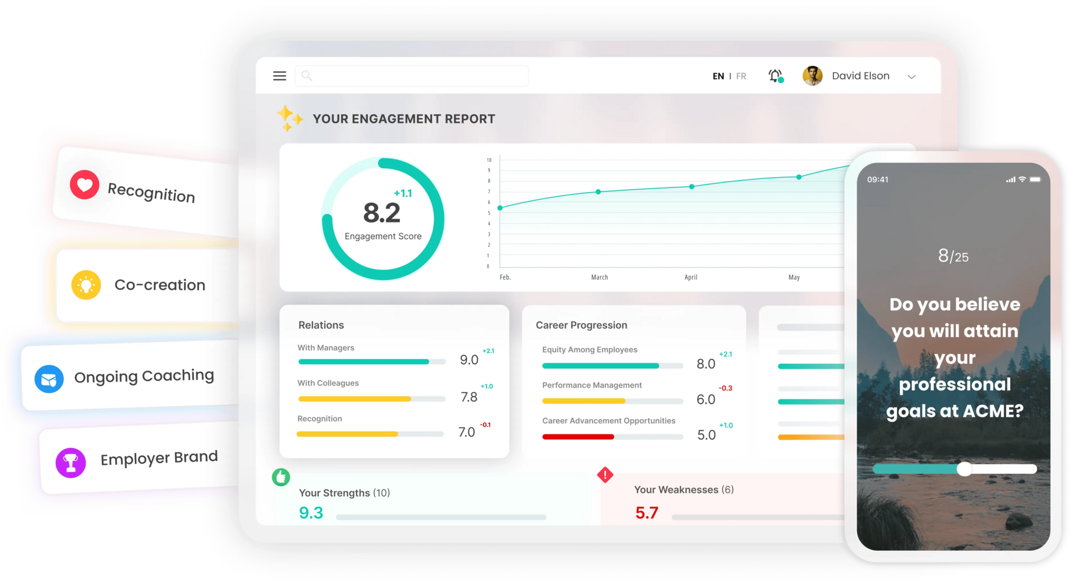
Complementary Modules
Tools to improve our practices!
On [Date]
1
You’ll receive an email to log into the Amélio platform.
2
You’ll be able to access Amélio modules at any time at any time.
3
Let’s explore these modules together today!

Slide 11
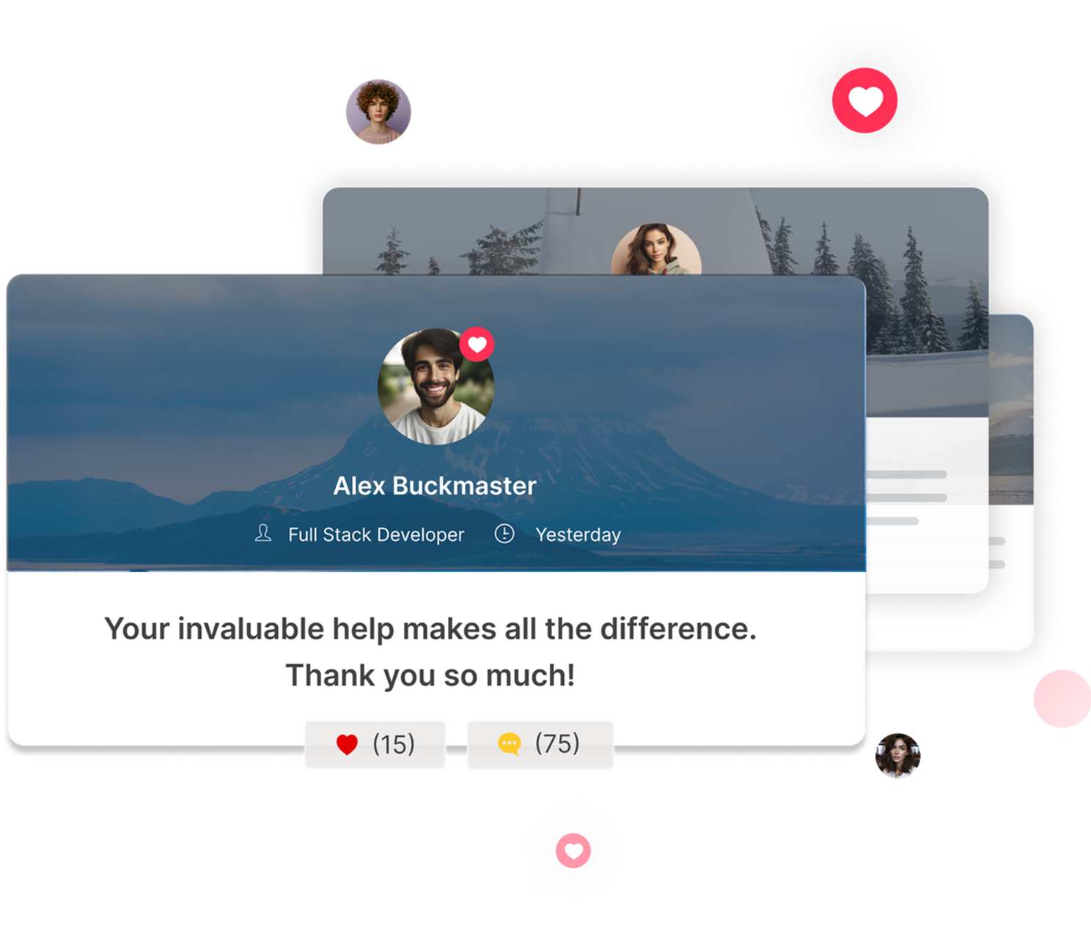

Complementary Modules
Peer-to-peer Recognition
Brighten your colleagues’ day!
A tool designed to let you give private or public recognition and strengthen the sense of belonging across the organization.
Use customizable cards - Celebrate appreciated behaviors aligned with our culture.
Spotlight efforts – Acknowledge successes, contributions, and involvement of your colleagues.
Amplify positivity - React to recognitions to show support and increase impact.
Gain visibility - Your manager will be notified when you receive recognition.

Slide 12
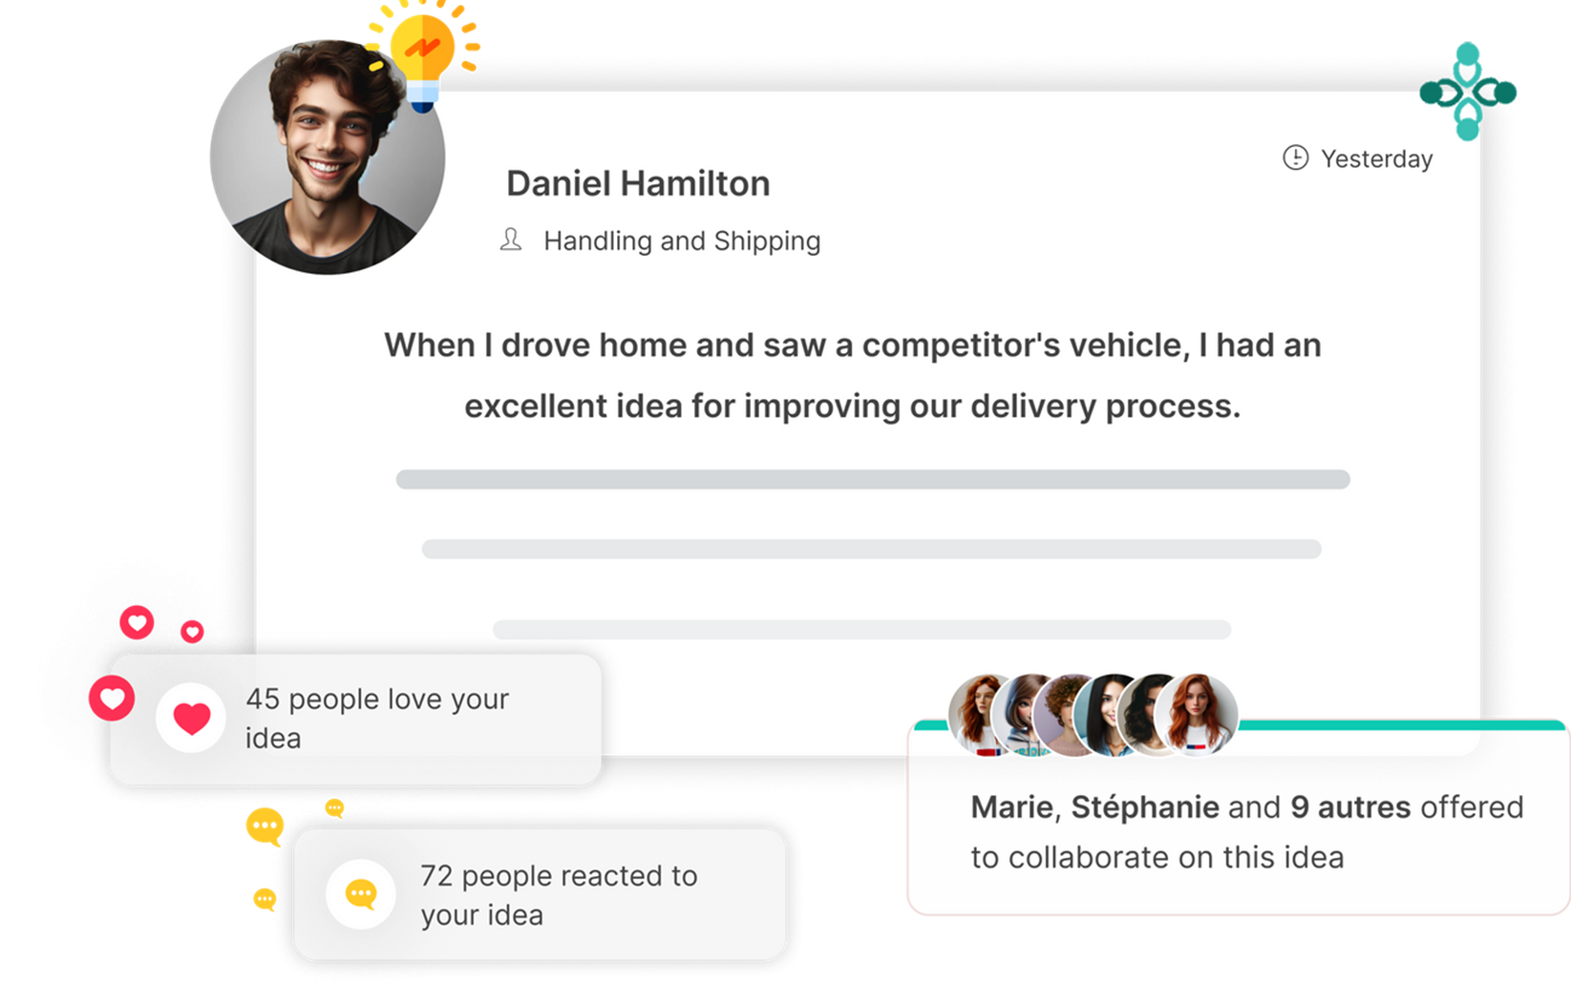

Complementary Modules
CoLab
Take part in decisions and transformations!
A tool designed to tap into collective intelligence and find concrete solutions to challenges or strategic issues.
Share your expertise - Propose improvement ideas aligned with real experiences.
Fuel reflection - React to ideas shared by your colleagues and move the discussion forward.
Break the routine - Volunteer to collaborate on ideas that excite you.

Slide 13
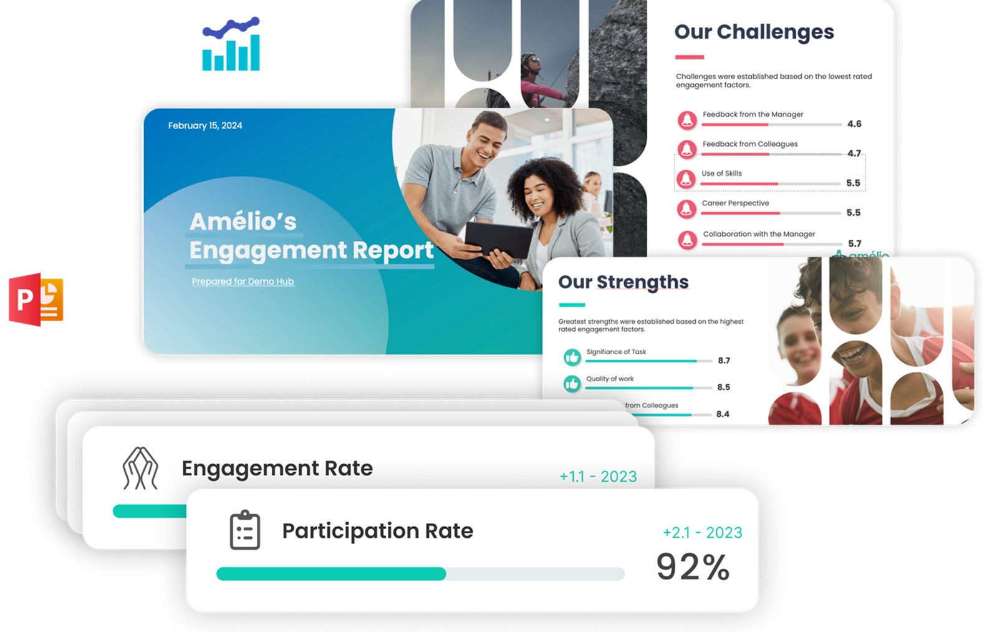
Next Steps
  Results analysis[Date to date]
  Highlighting our collective strengths
  Action plan to address raised concerns
Mobilization is a shared responsability!
Everyone has a role to play in building a workplace that reflects and inspires us.🚀

Slide 14

Q&A Session

